Slide 1
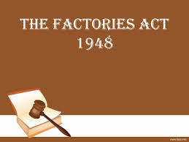
PRESENTED BY-
Dr. Srinibash Dash
Associate Professor & Head
School of Management
Gangadhar Meher University

Slide 2
CONTENTS-
INTRODUCTION
FACTORIES ACT IN INDIA
DEFINATIONS
OBJECTIVES
PENALTIES UNDER THE FACTORY ACT
PROVISION REGARDING FACTORIES ACT
CASE STUDY

Slide 3
INTRODUCTION-
In great Britain the second half of the 18th century, there was a rapid growth of industrial towns & factories.
As it was started without planning, they employed the women as well as their children in factories who needed to work for more than 12 hours a day.
Some of the employees took initiative to implement labor legislations, Factories Act came into existence in 1819.
After some modifications, the final amended of Factories Act took place in 1948.

Slide 4

FACTORIES ACT IN INDIA-
In India, the First factories Act was passed in 1881. This Act was basically designed to protect children and to provide few measures for health and safety of the workers.
This law was applicable to only those factories, which employed 100 or more workers.
In 1891 another Factories Act was passed which extended to the factory's employee 50 or more workers.

Slide 5
DEFINATIONS-
“Factory” is defined in section 2(m) of the Act. It means any premises including the precincts thereof-
a) Whereon 10 or more workers are working, or were working on any day of the preceding 12 months, and in any part of which a manufacturing process is being carried on with the aid of power, or is ordinarily so carried on; or
b) Whereon 20 or more workers are working, or were working on any day of the preceding 12 months, and in any part of which a manufacturing process is being carried on without the aid of power, or is ordinarily so carried on.
But does not include a mine subject to the operation of the Mines Act, 1952 or a mobile unit belonging to the Armed forces of the Union, a railway running shed or a hotel, restaurant or eating place.

Slide 6
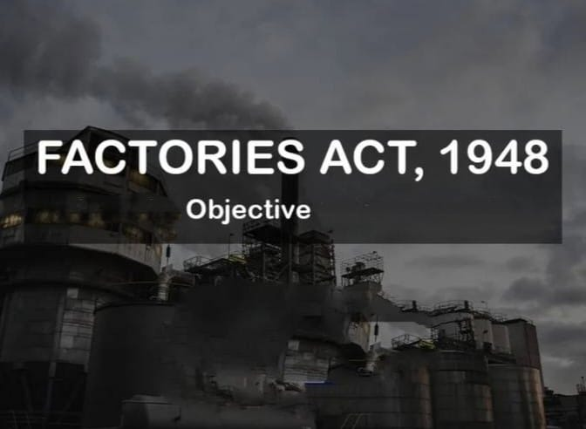
0bjectives of Factory Act 1948
The main objectives of the Factory Act 1948 are as follows:
Health, Safety, and Welfare
Regulation of Working Hours
Protection of Young Workers
Compensation for Injuries

Slide 7

Penalties under the Factory Act 1948
Penalty for Contravention of Provisions
Penalty for Failure to Maintain Registers
Penalty for Employment of Child Labour
Penalty for Unsafe Working Conditions
Penalty for Overtime Violations
Penalty for Non-Compliance with Health
and Safety Regulations
In general, penalties under the Factory Act are intended to prevent
violations and ensure that factories operate in a manner that is fair and
safe for all workers.

Slide 8
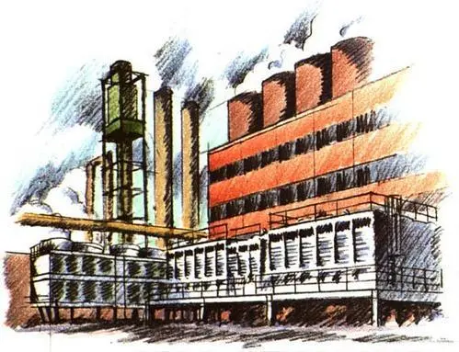
-:PROVISON REGARDING FACTORIES ACT:-
Health provision
Employee safety
Employee welfare
Working hour of adult workers
Further restriction on employment of women
Provision of employment of young children

Slide 9
CASE STUDY:
Here's a case study on the Factories Act in XYZ Corporation:
Case Study: XYZ corporation's compliance with the factories act
Background: XYZ corporation is a leading manufacturer of textiles in India. The company has a large factory in Mumbai, employing over 1,000 workers. In recent years, the company has faced several challenges related to worker safety and health.
Problem Statement: XYZ corporation was facing issues related to non-compliance with the factories act, 1948. The company had received several notices from the labor department for non-compliance with various provisions of the Act.

Slide 10
KEY ISSUES:
Safety and Health: The factory did not have adequate safety measures in place, leading to several accidents and injuries.
2. Working Hours: Workers were working for more than 48 hours a week, which is the maximum limit prescribed under the Factories Act.
3. Wages and Benefits: Workers were not being paid the minimum wages prescribed under the Act, and were also not receiving other benefits such as overtime pay and leave.
4. Record Keeping: The company was not maintaining proper records of worker attendance, wages, and working hours.

Slide 11
SOLUTIONS:
Appointment of Safety Officer: The company appointed a safety officer to oversee safety and health measures in the factory.
2. Implementation of Safety Measures: The company implemented various safety measures such as installation of safety equipment, training of workers, and regular safety audits.
3. Compliance with Working Hours: The company ensured that workers were not working for more than 48 hours a week.
4. Payment of Minimum Wages and Benefits: The company ensured that workers were paid the minimum wages prescribed under the Act, and also received other benefits such as overtime pay and leave.
5. Maintenance of Records: The company maintained proper records of worker attendance, wages, and working hours.

Slide 12
OUTCOMES:
Improved Safety and Health: The implementation of safety measures led to a significant reduction in accidents and injuries.
Compliance with Labor Laws: The company ensured compliance with the Factories Act and other labor laws.
Increased Worker Satisfaction: Workers were satisfied with the improved working conditions and benefits.
Reduced Labor Costs: The company reduced labor costs by avoiding penalties and fines for non-compliance.
Conclusion:
XYZ Corporation's compliance with the Factories Act led to improved safety and health, compliance with labor laws, increased worker satisfaction, and reduced labor costs. The company's experience highlights the importance of compliance with labor laws and regulations to ensure a safe and healthy work environment.

Slide 13


